Slide 1
Title!!!
Combine Heuristic Search and Deep Reinforcement Learning to Play Angry Birds

Slide 2
Introduction
Angry Birds is a popular physics-based simulation game. In the game, players use a slingshot to launch birds at pigs stationed in or around various structures with the goal of destroying all the pigs on the playing field. As players advance through the game new types of birds become available, some with special abilities that can be activated by the player at proper time.
The goal of the Angry Birds AI Competition is to build an intelligent Angry Birds playing agent that can play new game levels as good or better than the best human players. Humans are very good at predicting consequences of physical actions, but it is difficult for AI.

Slide 3
Existing Approaches
So far most of the work was concerned with the representation of the different types of objects in Angry Birds. Lin et al. [1] classify the objects into dynamic and static ones according to their shape and attributes. In [5], the authors assign a numerical score to each reachable object based on its physical properties to reflect the extent of damage it suffers if being hit, and shoots at objects with low stability but high influence on pig or shelters of pigs.

Slide 4
Existing Approaches
Polceanu and Buche [13] build their decision making based on the theory of mental simulation. Their agent observes the effects of performing multiple simulations of different shots in a given game scene and selects the optimal solution based on these results.
Tziortziotis and Buche [4] use a tree structure to represent the objects in a game scene, and formulate the problem of selecting an object for shooting as a regression problem. They associate with each pair of object material and bird a Bayesian linear regression model, making decision according to the best prediction of the ensemble model.

Slide 5
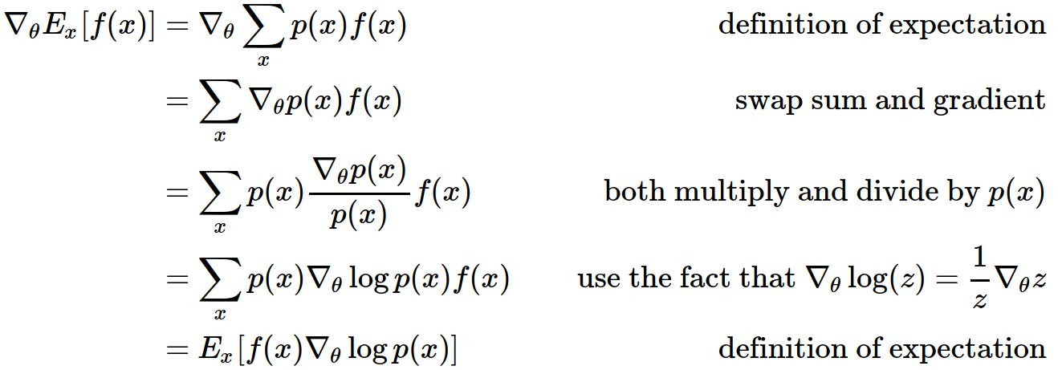
Combine Heuristic search and Deep Reinforcement Learning?

Slide 6
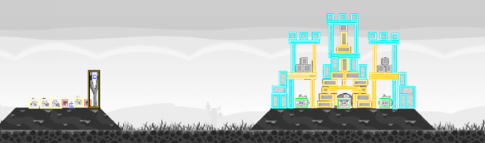
Game State Extraction
Crop a part a the screenshot and down-sample it
Change the background pixels to be zero and different numbers to represent different blocks
Target Point: 127
Pigs: 80
Dynamite: 100
Ice: -60
Wood: -90
Stone: -120

Slide 7
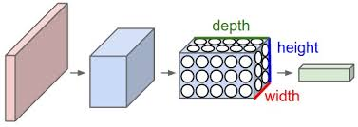
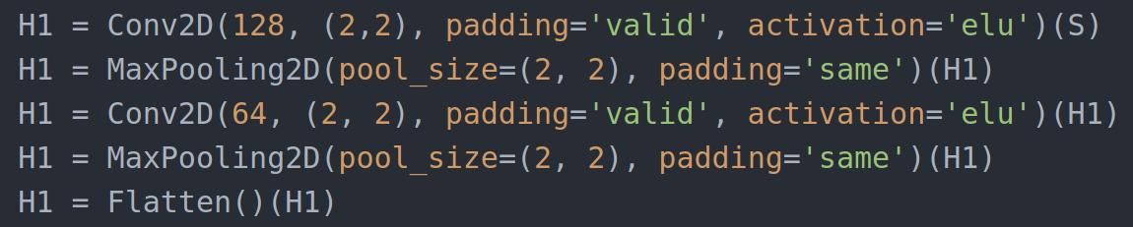
Game State Extraction
The game state extracted is the input of a convolutional neural network

Slide 8
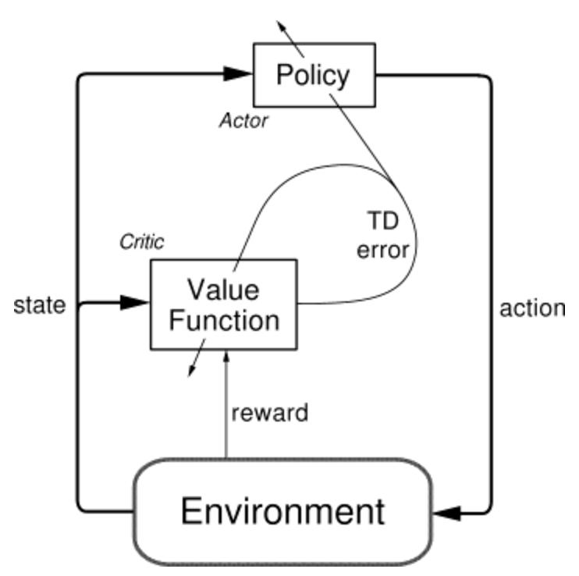
Deep Reinforcement Learning Model
Actor-critic Architecture:

Slide 9

Deep Reinforcement Learning Model
Policy Network:
Reward Function:

Slide 10

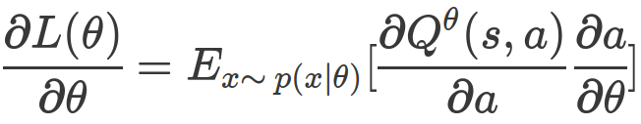
Deep Reinforcement Learning Model
Value Network:
Gradient for Policy network:

Slide 11
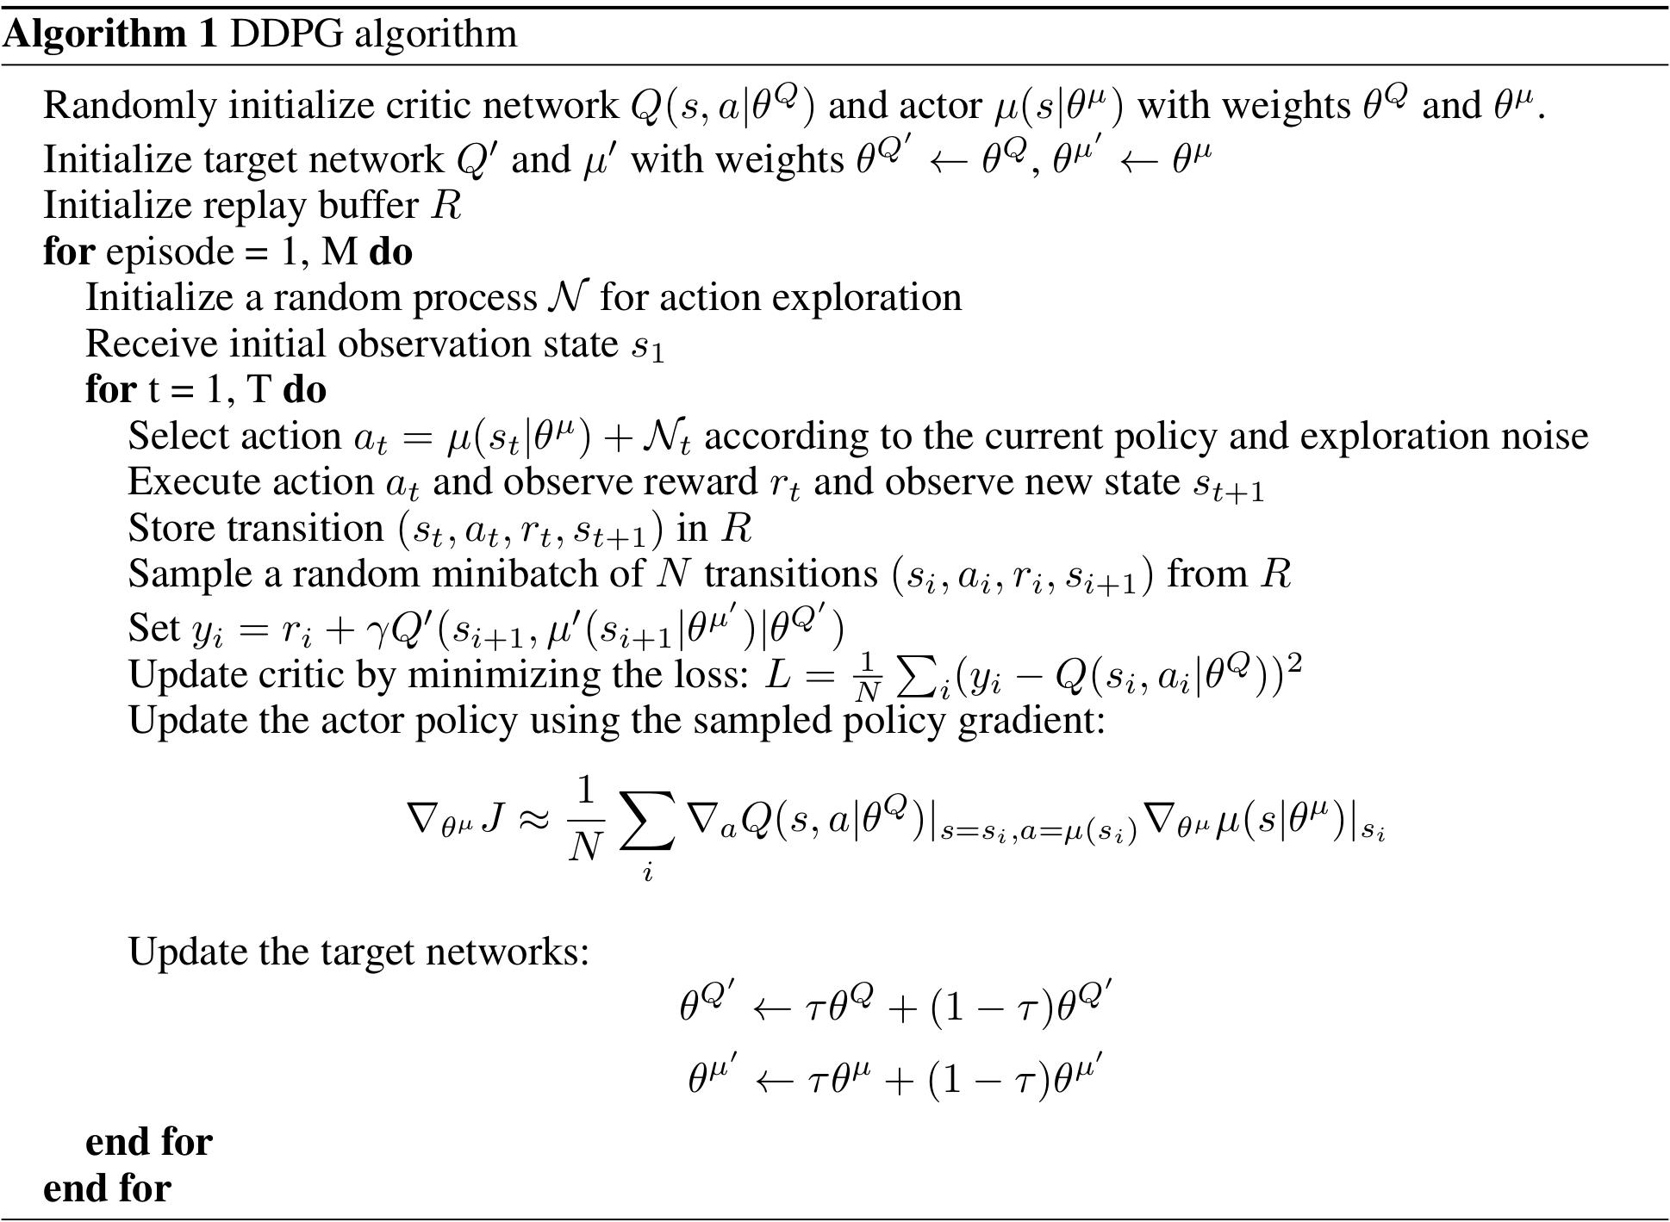

Slide 12
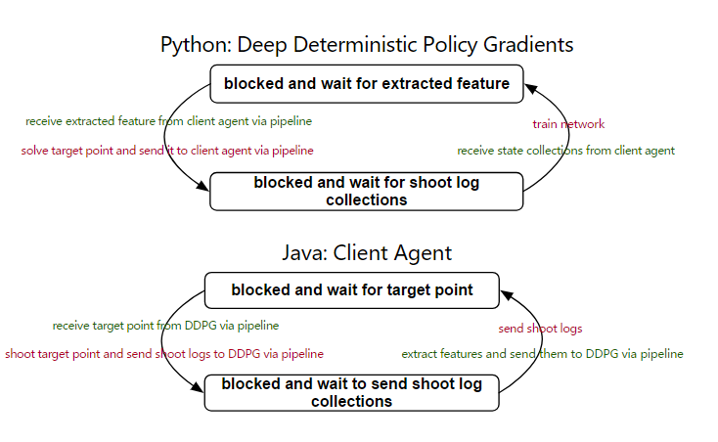
Pipeline Communication

Slide 13
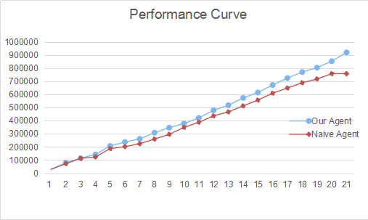
Performance Curve
level | Naive Agent | Our Agent(average)
1 | 29760 | 28570
2 | 43250 | 52383
3 | 40180 | 33530
4 | 10590 | 28108
5 | 63490 | 65450
6 | 14980 | 29373
7 | 22150 | 24088
8 | 35840 | 46915
9 | 36050 | 38553
10 | 52570 | 31400
11 | 39310 | 42323
12 | 48660 | 58370
13 | 30000 | 38505
14 | 45640 | 55640
15 | 44190 | 41028
16 | 52300 | 57355
17 | 39530 | 52565
18 | 39590 | 45855
19 | 29460 | 33545
20 | 40140 | 48630
21 | 0 | 67450
total score | 757680 | 919633

Slide 14
References
1. Lin, S., Zhang, Q., Zhang, H.: Object representation in Angry Birds game. In: IJCAI 2013 Symposium on AI in Angry Birds (2013)
2. Narayan-Chen, A., Xu, L., Shavlik, J. An empirical evaluation of machine learning approaches for Angry Birds. In: IJCAI 2013 Symposium on AI in Angry Birds (2013)
3. Nuradiansyah A, Ziberi E, Tirtarasa S, et al. SEABirds: An AHP Approach to Solve the Angry Birds AI Challenge[J].
4. Tziortziotis, N., Papagiannis, G., Blekas, K. A Bayesian ensemble regression framework on the Angry Birds game. In: ECAI 2014 Symposium on Artificial Intelligence in Angry Birds (2014)
5. Wa l,ega, P., Lechowski, T., Zawidzki, M. Qualitative physics in Angry Birds: first results. In: ECAI 2014 Symposium on Artificial Intelligence in Angry Birds (2014)
6. Zhang, P., Renz, J. Qualitative spatial representation and reasoning in Angry Birds: first results. In: IJCAI 2013 Symposium on AI in Angry Birds (2013)
7. Zhang, P., Renz, J. Qualitative spatial representation and reasoning in Angry Birds: the extended rectangle algebra. In: Proceedings of the 14th International Conference on Principles of Knowledge Representation and Reasoning, KR14, p. to appear, Vienna, Austria (2014)

Slide 15
References
8. Renz J. AIBIRDS: The Angry Birds Artificial Intelligence Competition[C]//AAAI. 2015: 4326-4327.
9. Paul A, Hüllermeier E. A CBR Approach to the Angry Birds Game[C]//ICCBR (Workshops). 2015: 68-77.
10. Calimeri F, Fink M, Germano S, et al. Angry-HEX: an artificial player for angry birds based on declarative knowledge bases[J]. IEEE Transactions on Computational Intelligence and AI in Games, 2016, 8(2): 128-139.
11. Jutzeler A, Katanic M, Li J J. Managing luck: A multi-armed bandits meta-agent for the angry birds competition[J]. AI Birds Competition, 2013.
12. Borovička T, Špetlík R, Rymeš K. Datalab birds angry birds ai[J]. 2014.
13. Polceanu, M., Buche, C.: Towards a theory-of-mind-inspired generic decisionmaking framework. In: IJCAI 2013 Symposium on AI in Angry Birds (2013)
14. Ferreira, L.A., Lopes, G.A.W., Santos, P.E.: Combining qualitative spatial representation utility function and decision making under uncertainty on the Angry Birds domain. In: IJCAI 2013 Symposium on AI in Angry Birds (2013)

Slide 16
Thank you for watching

